Slide 1
TENDER TOUCH
BABY CARE PRODUCTS
GUIDE NAME
STUDENT NAME
DR. A. ROSLIN DEEPA
MCA.,M.PHIL.,Ph.D.,
ASSISTANT PROFESSOR
DEPARTMENT OF IT
THE AMERICAN COLLEGE
V. MILLEE GUPTA
ROLL NO: 22BIT52
DEPARTMENT OF IT
THE AMERICAN COLLEGE

Slide 2
ABSTRACT
“Tender Touch” is a web application where we can discover the perfect blend of care and convenience ensuring that every item supports your baby’s health, comfort and development. The product are crafted from purest and natural ingredient.
The online platform aims to streamline the shopping experience by offering selected range of baby care products. It provides a user-friendly platform. It contains multiple payment gateways that are secure.
By leveraging technology, this ecommerce site provides evolving needs to modern family. This website aims to educate and empower users by providing insightful content on the significance of products.
/
.
New Chinese business style

Slide 3
DFD [Data Flow Diagram]
level 0
Request for Login
ONLINE BABY CARE PRODUCTS SHOPPING
Request for Registration
ADMIN
USER
User updates
Order management
USER TABLE
ADMIN LOGIN

Slide 4
level 1
USER
START
ADMIN
PRODUCTS
YES
LOGIN
USER
TABLE
NO
LOGIN
REGISTER
ADD PRODUCTS
SEARCH PRODUCTS
ADD CATEGORY
VIEW PRODUCTS
ADD AGEGROUPS
USER
ORDERS
ADD TO CART
MANAGE PAYMENT
NO
PAYMENT
LOGOUT
YES
CASH ON DELIVERY
REPORTS
STOP

Slide 5
level 2
INSERT CATEGORIES
CATEGORY
REGISTER
PRODUCTS
VIEW PRODUCTS
VIEW CATEGORIES
LOGOUT
CART DETAILS
ADD TO CART
INSERT AGEGROUPS
AGEGROUP
CHECKOUT
VIEW AGEGROUPS
PAYMENTS
USER
ADMIN
PAYMENTS
YES
MANAGE ORDERS
ORDERS
CASH ON DELIVERY
NO
USER LIST
USERS LIST
LOGIN
CONTINUE SHOPPING
MANAGE PAYMENT
USERS TABLE

Slide 6
DATABASE TABLE
PRODUCT TABLE
FIELD NAME | DATA TYPE | SIZE | CONSTRAINTS
Product Id | Int | 11 | Primary Key
Product Title | Varchar | 100 | Not null
Product description | Varchar | 255 | Not null
Product keywords | Varchar | 255 | Not null
Category Id | Int | 11 | Not null
Agegroup Id | Int | 11 | Not null
Product image1 | Varchar | 255 | Not null
Product image2 | Varchar | 255 | Not null
Product image3 | Varchar | 255 | Not null
Product price | Varchar | 100 | Not null
Date | timestamp | - | Not null
Status | Varchar | 100 | Not null

Slide 7
CATEGORIES TABLE
FIELD NAME | DATA TYPE | SIZE | CONSTRAINTS
Category Id | Int | 11 | Primary Key
Category Title | Varchar | 100 | Not null
AGEGROUPS TABLE
FIELD NAME | DATA TYPE | SIZE | CONSTRAINTS
Agegroup Id | Int | 11 | Primary Key
Agegroup Title | Varchar | 100 | Not null

Slide 8
USER TABLE
FIELD NAME | DATA TYPE | SIZE | CONSTRAINTS
User Id | Int | 11 | Primary Key
Username | Varchar | 100 | Not null
User email | Varchar | 100 | Not null
User password | Varchar | 255 | Not null
User image | Varchar | 255 | Not null
User IP | Varchar | 100 | Not null
User address | Varchar | 255 | Not null
User mobile | Varchar | 20 | Not null

Slide 9
CART DETAILS TABLE
FIELD NAME | DATA TYPE | SIZE | CONSTRAINTS
Product Id | Int | 11 | Primary Key
IP Address | Varchar | 255 | Not null
Quantity | Int | 100 | Not null
PENDING ORDERS TABLE
FIELD NAME | DATA TYPE | SIZE | CONSTRAINTS
Order Id | Int | 11 | Primary Key
User Id | Int | 255 | Not null
Invoice number | Int | 255 | Not null
Product Id | Int | 11 | Not null
Quantity | Int | 255 | Not null
Order status | Varchar | 255 | Not null

Slide 10
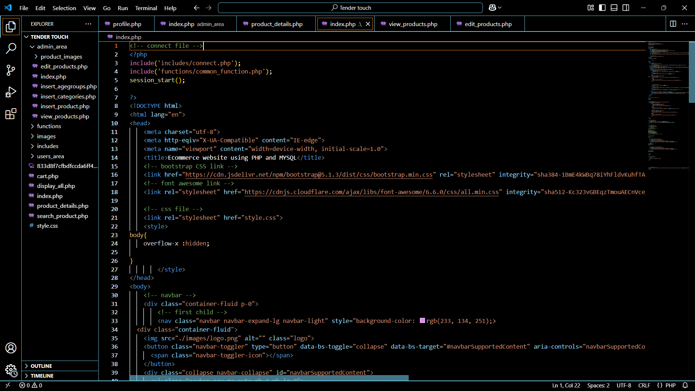
IMPLEMENTATION

Slide 11
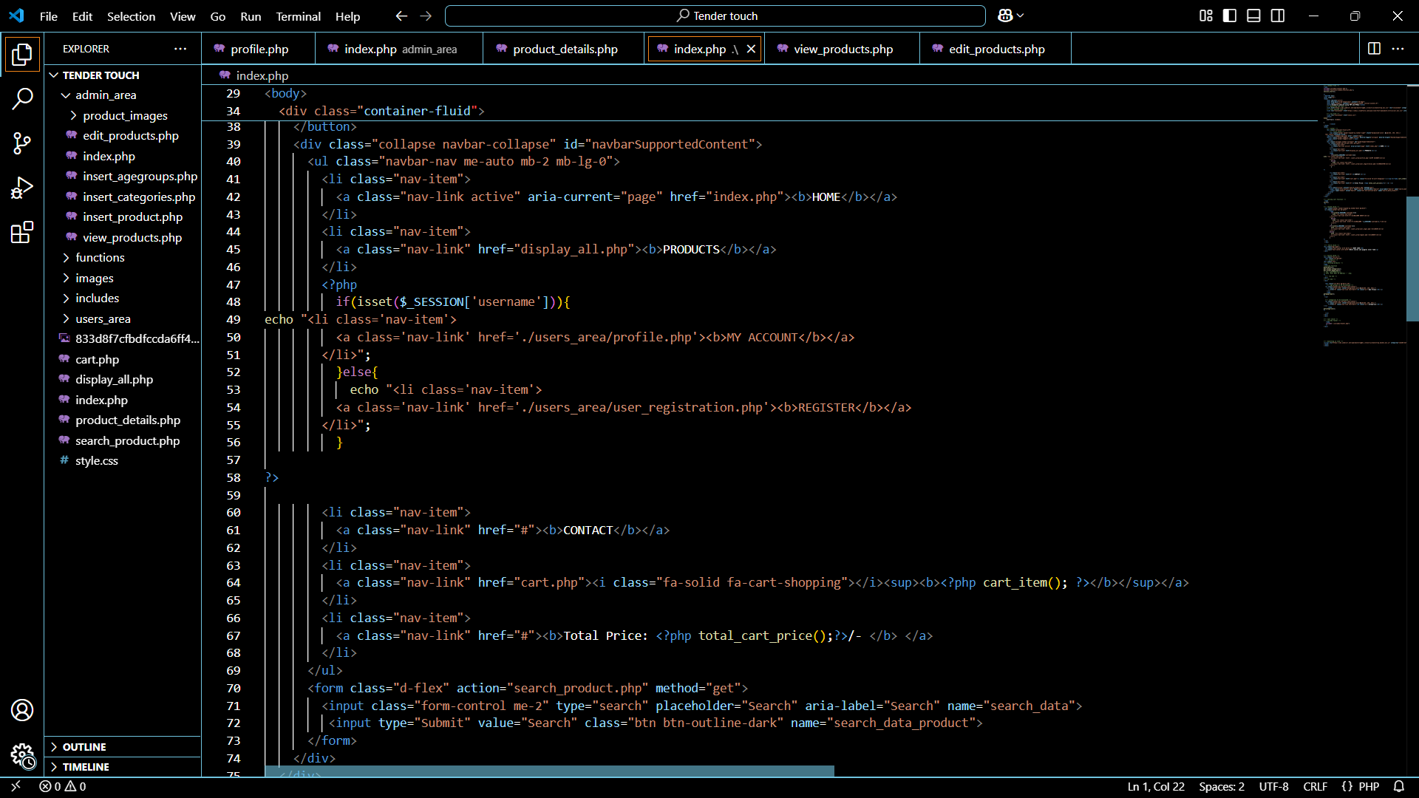

Slide 12
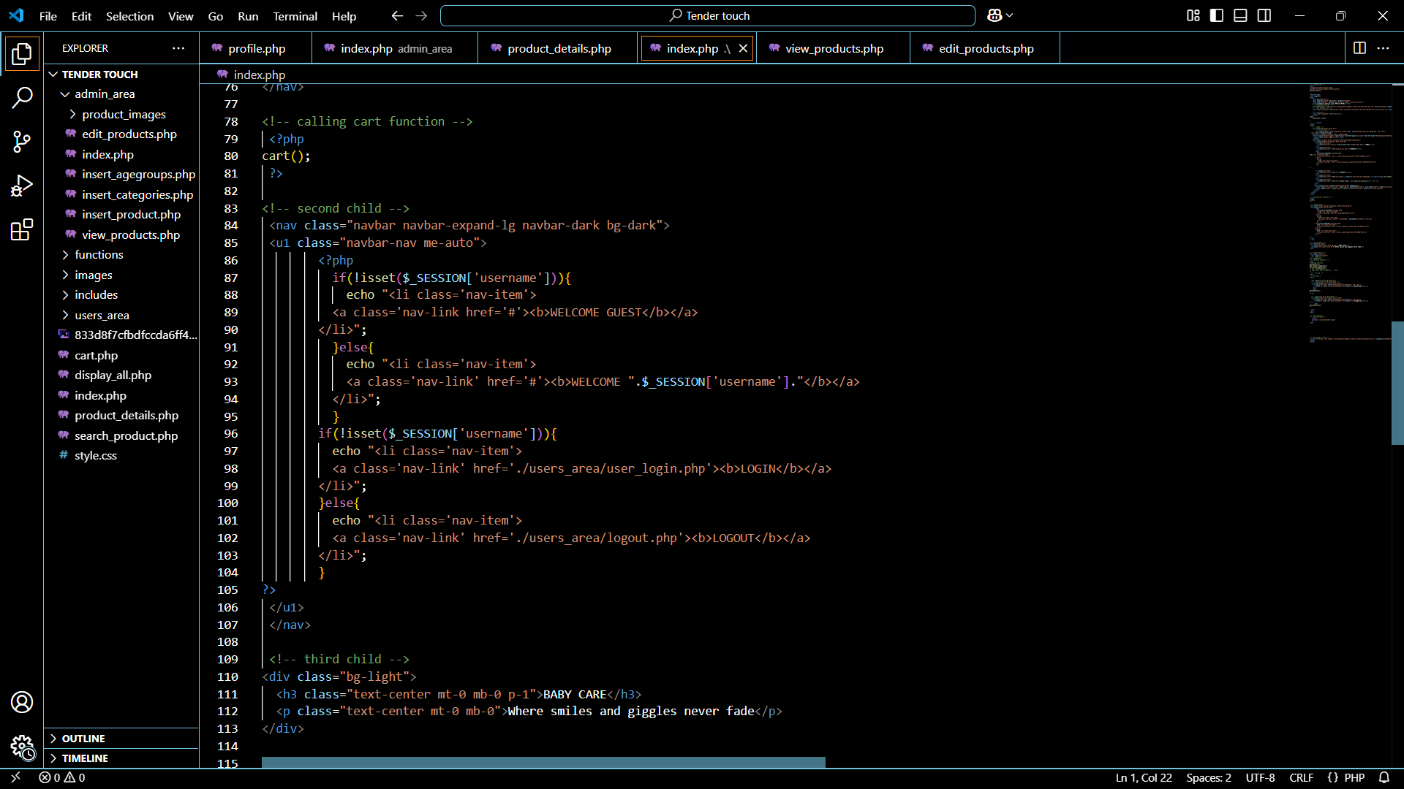

Slide 13
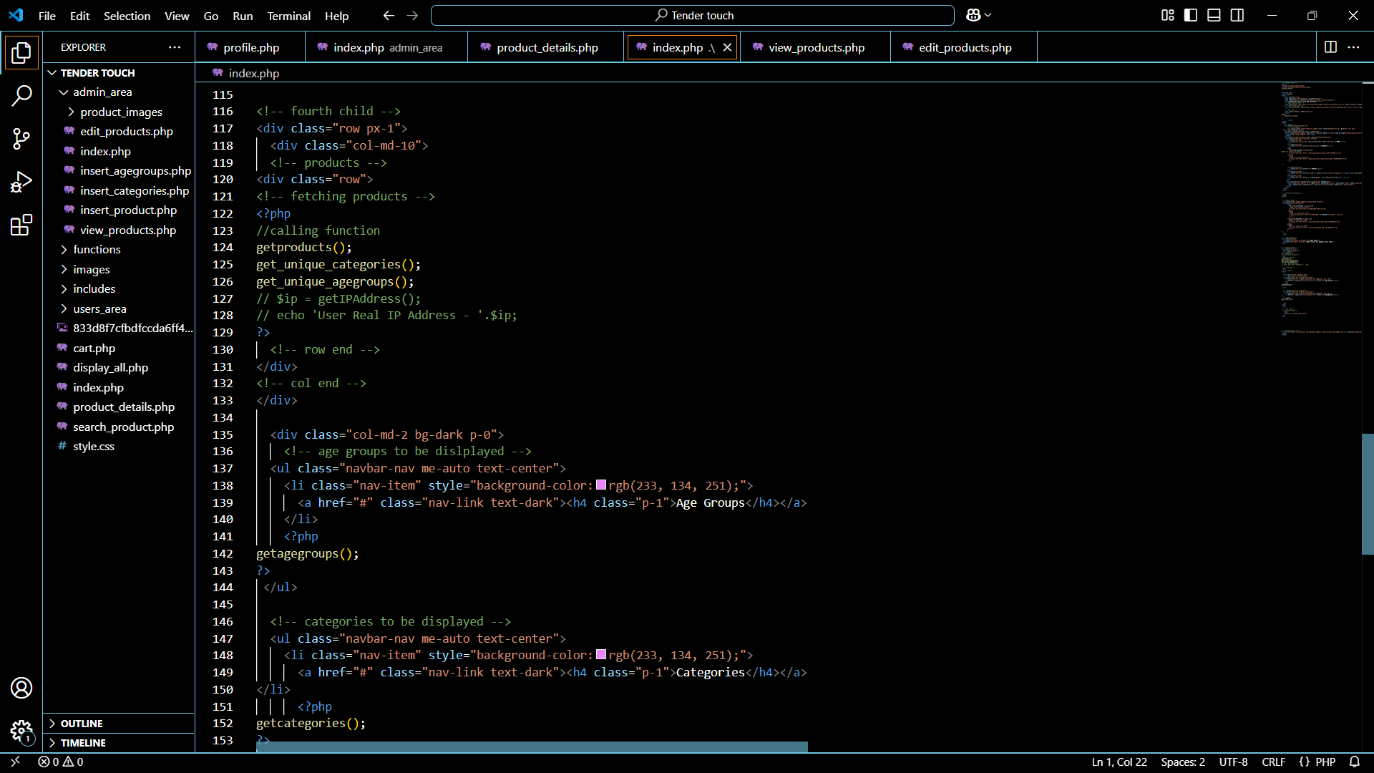

Slide 14
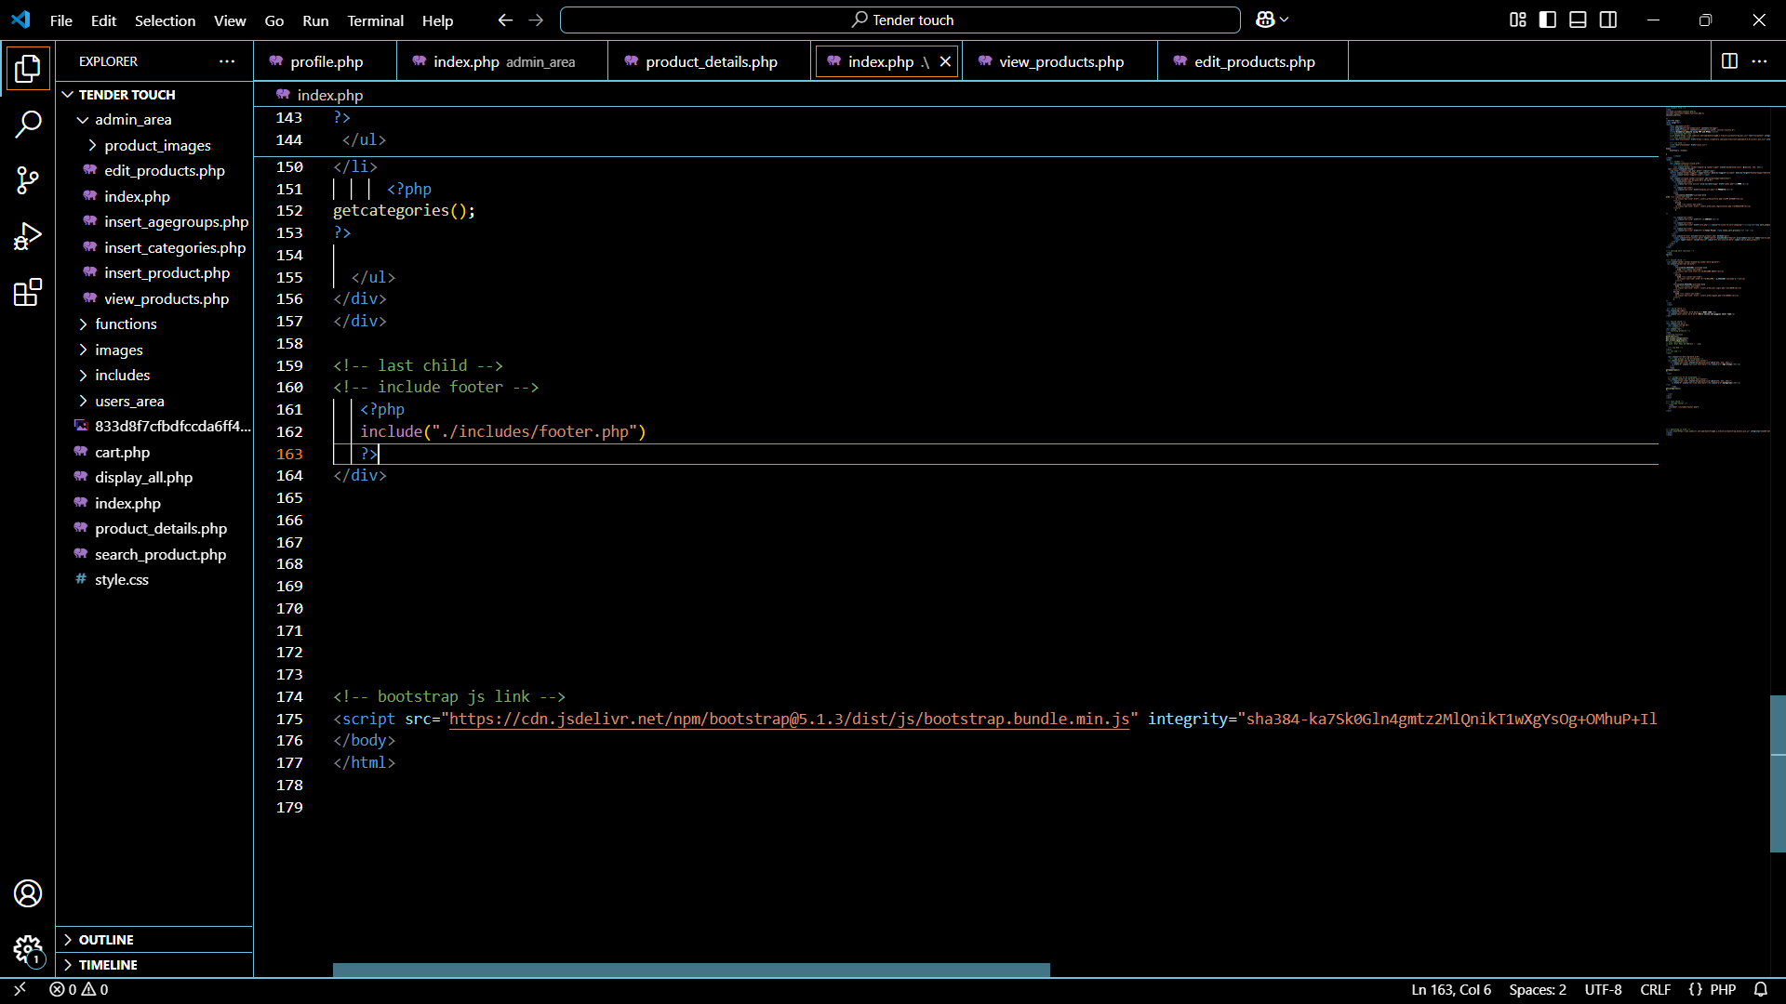

Slide 15
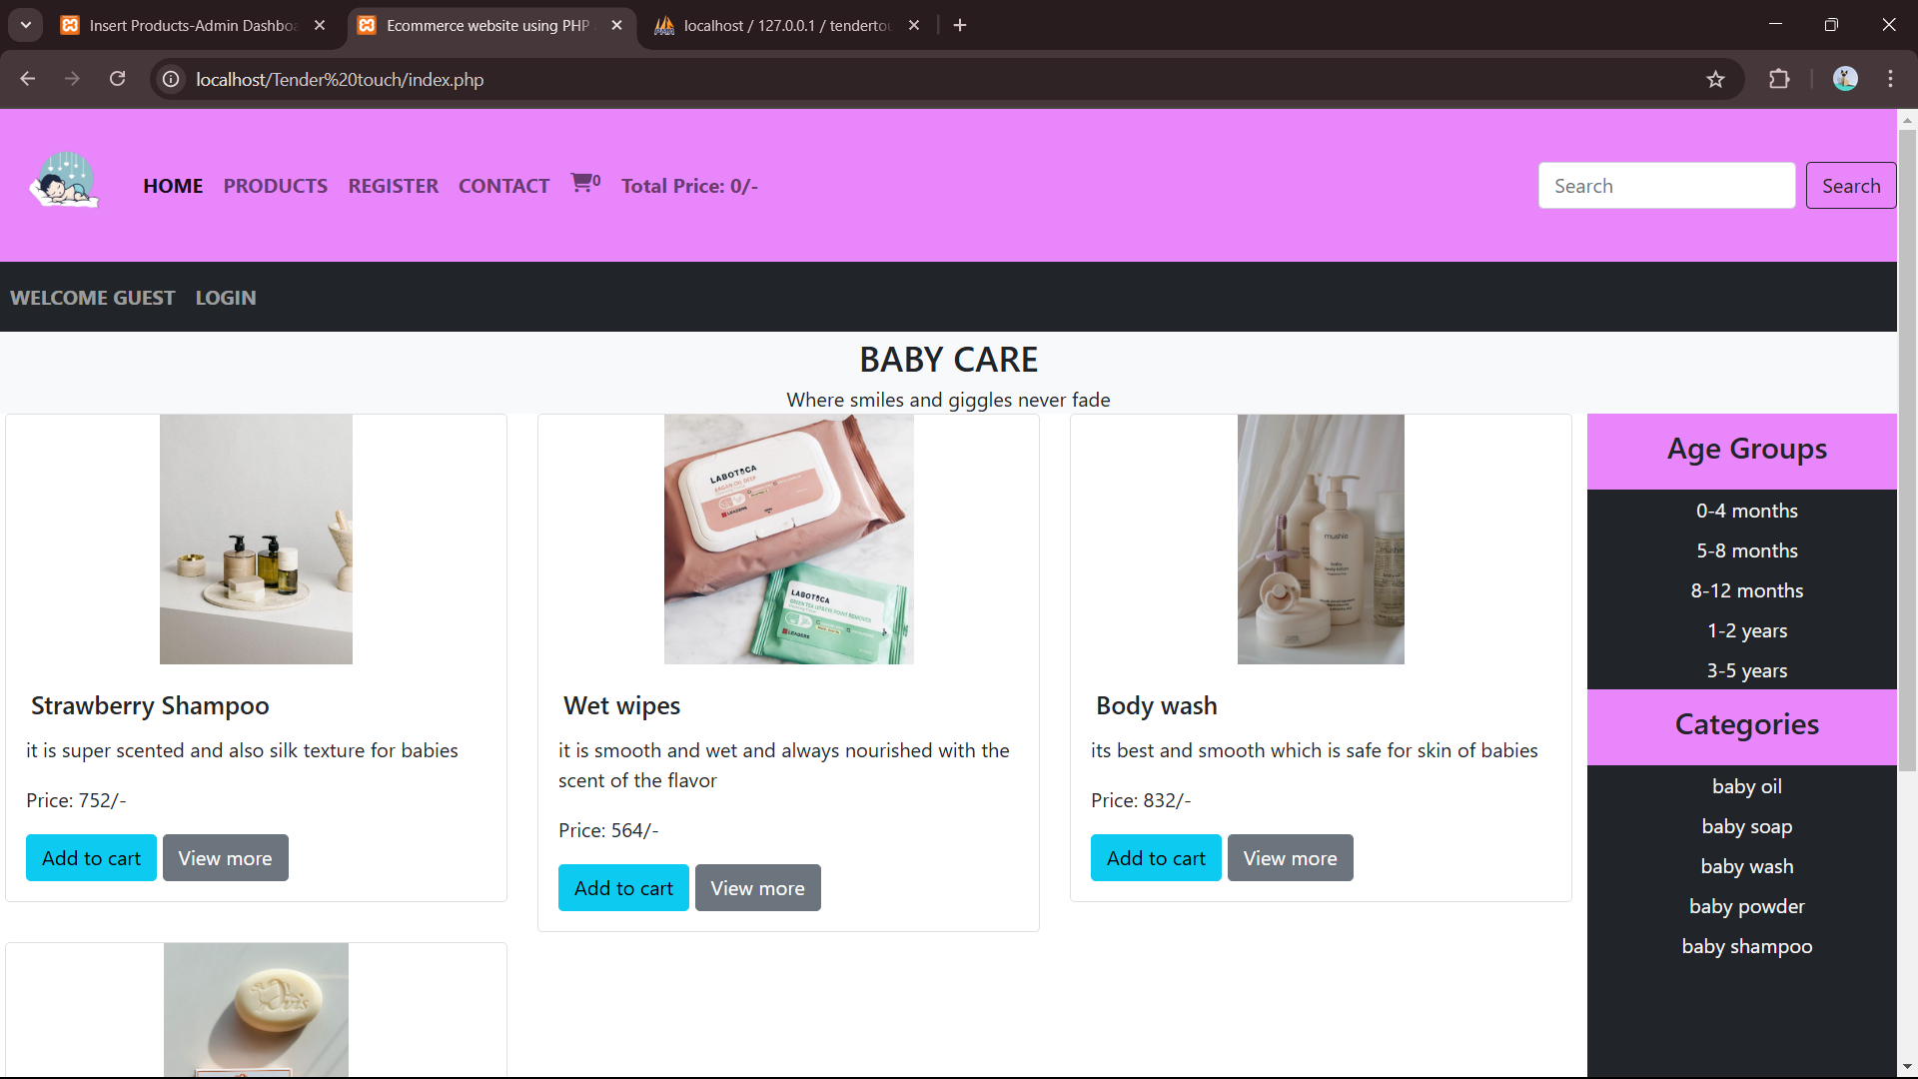
SCREENSHOTS

Slide 16
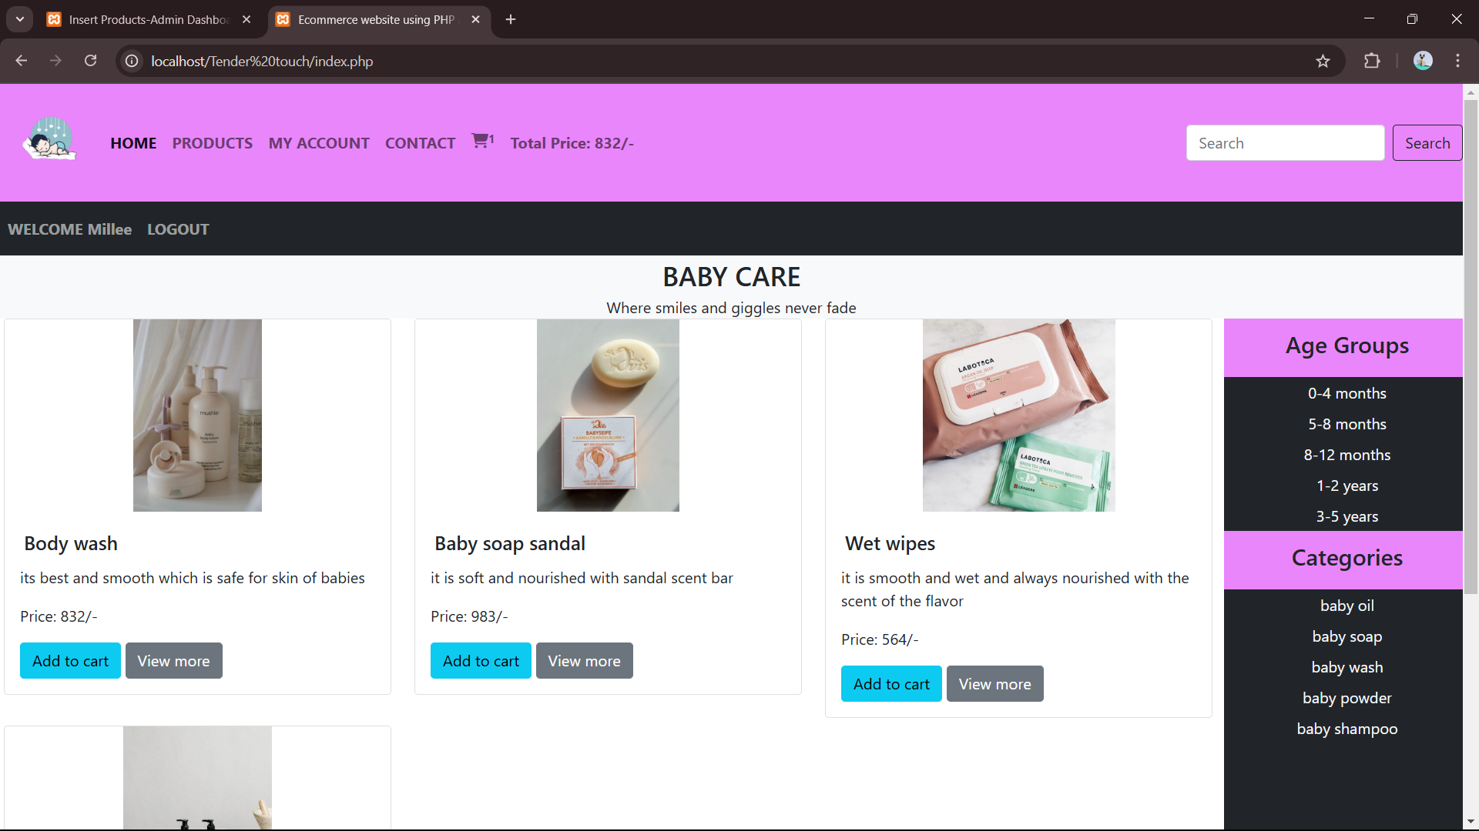
SCREENSHOTS

Slide 17
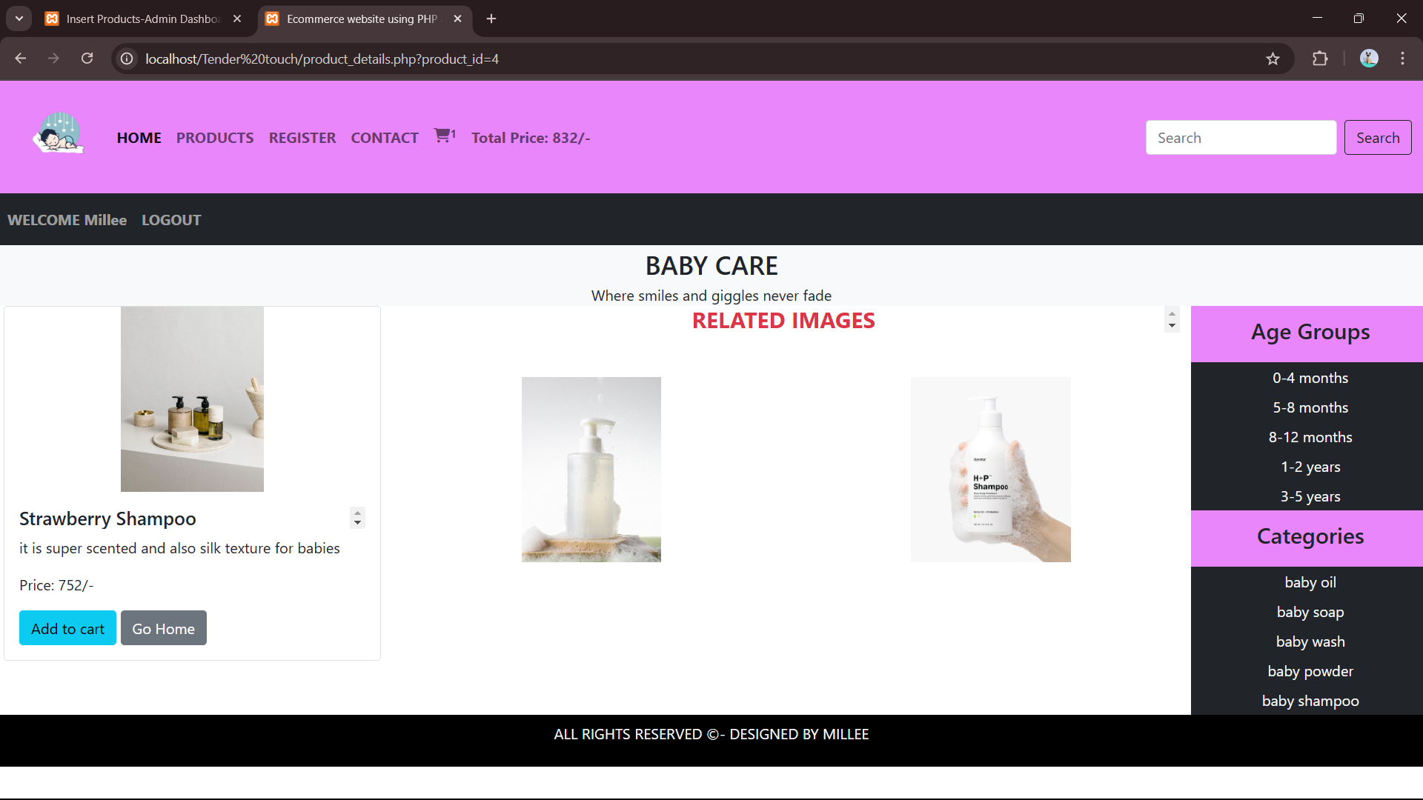

Slide 18
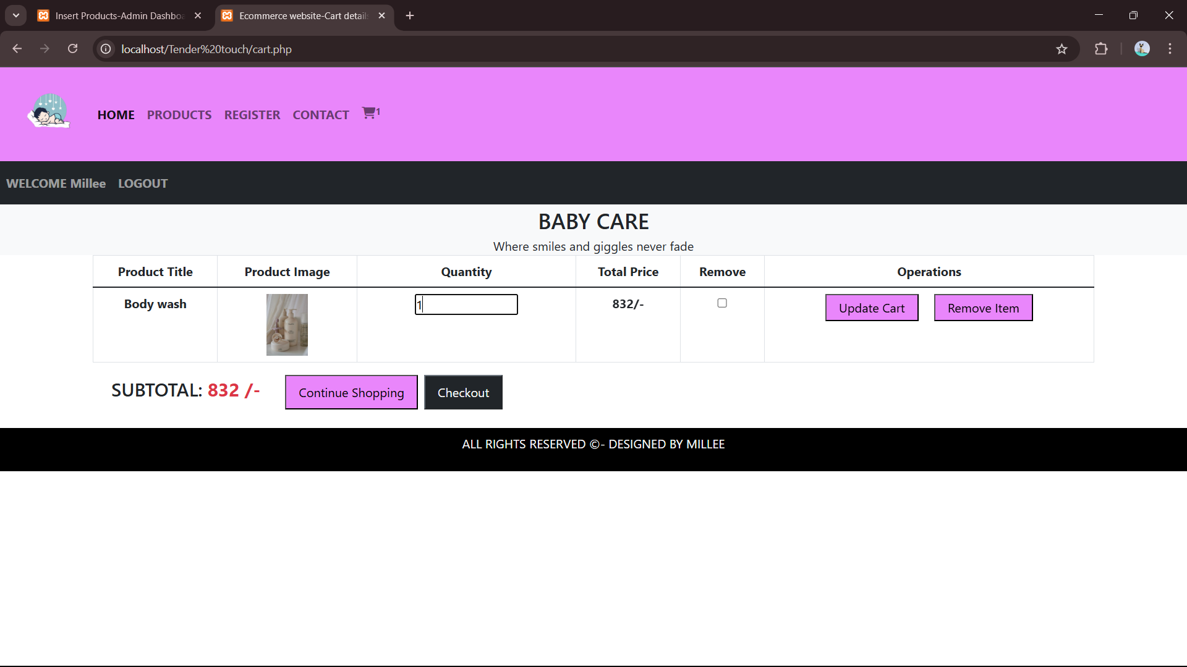

Slide 19
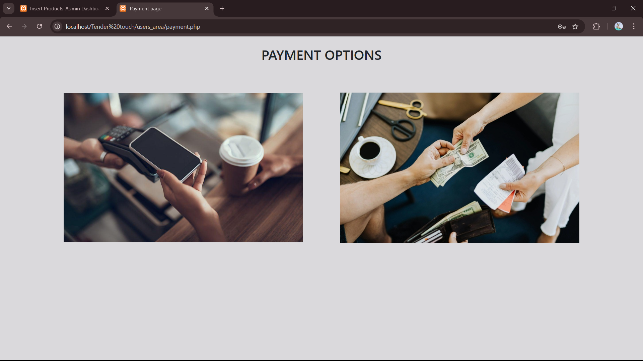

Slide 20
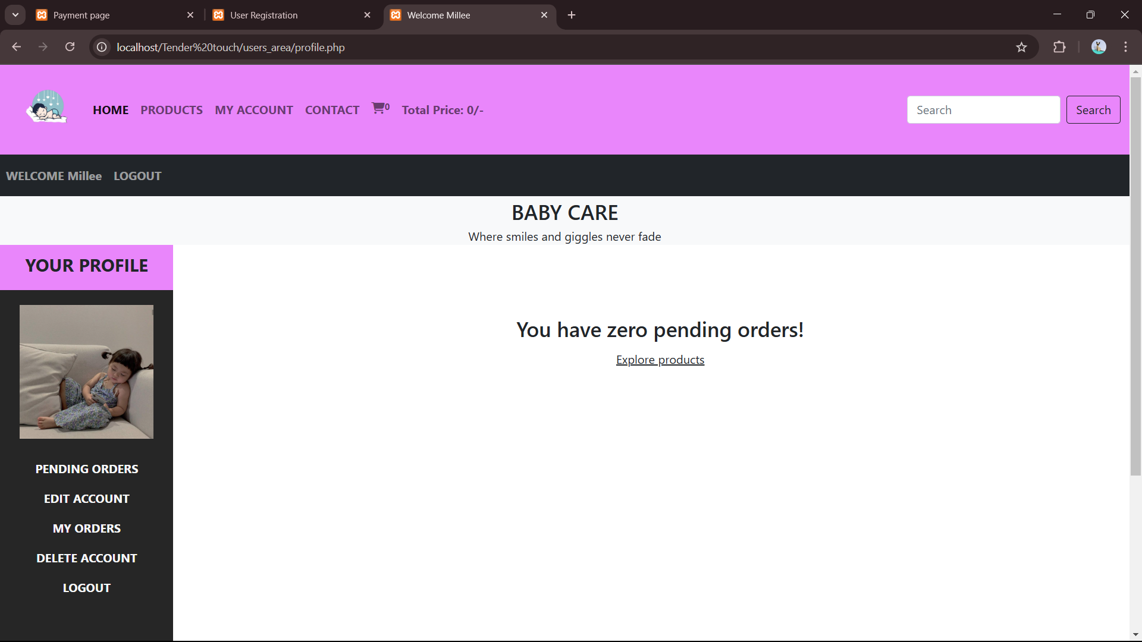

Slide 21
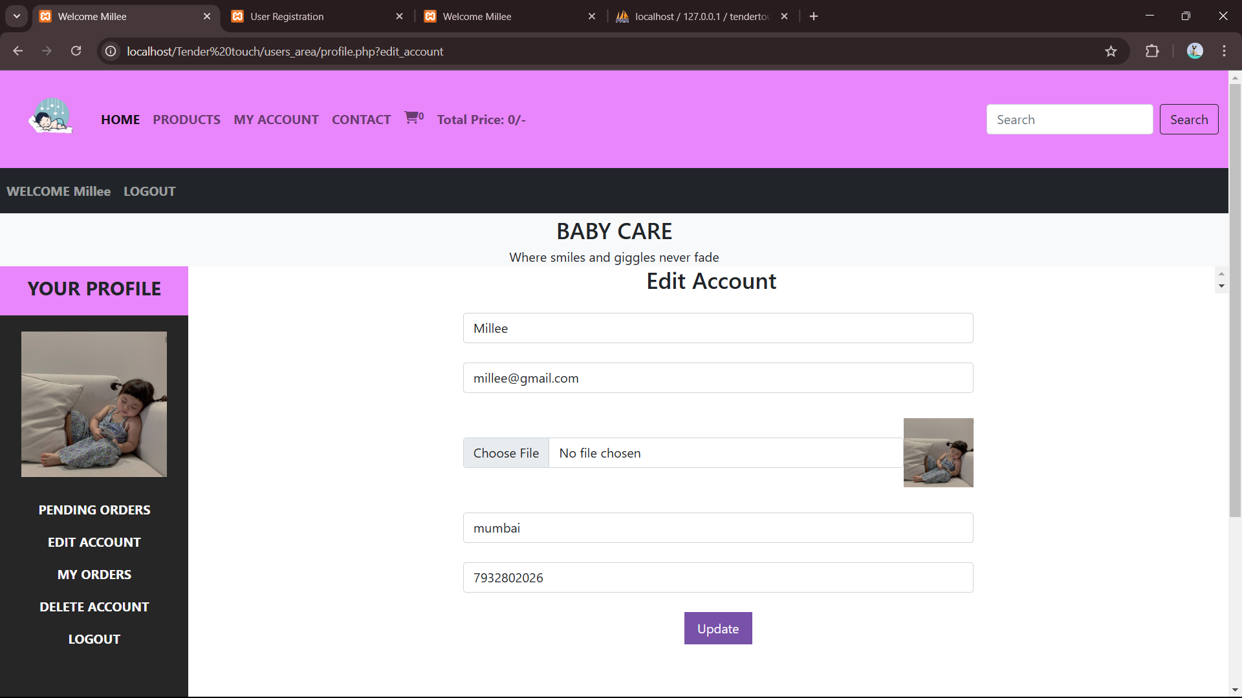

Slide 22
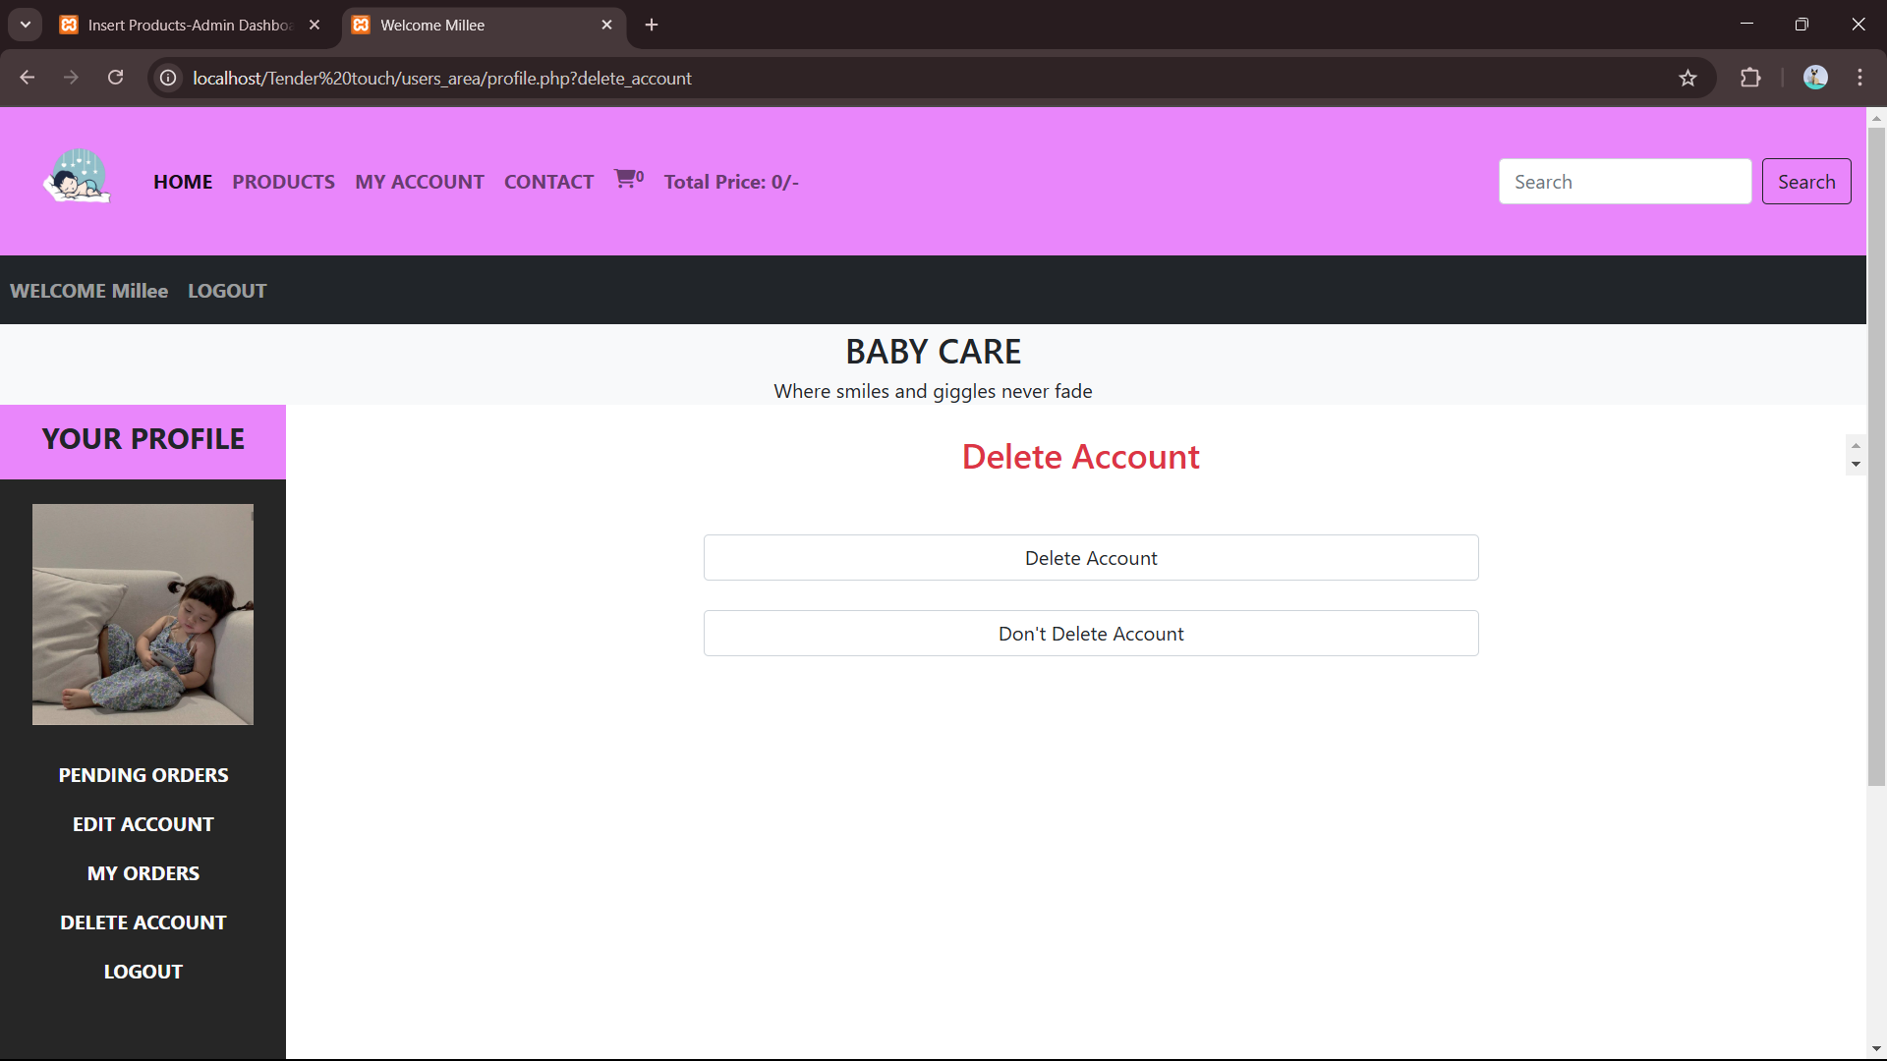

Slide 23
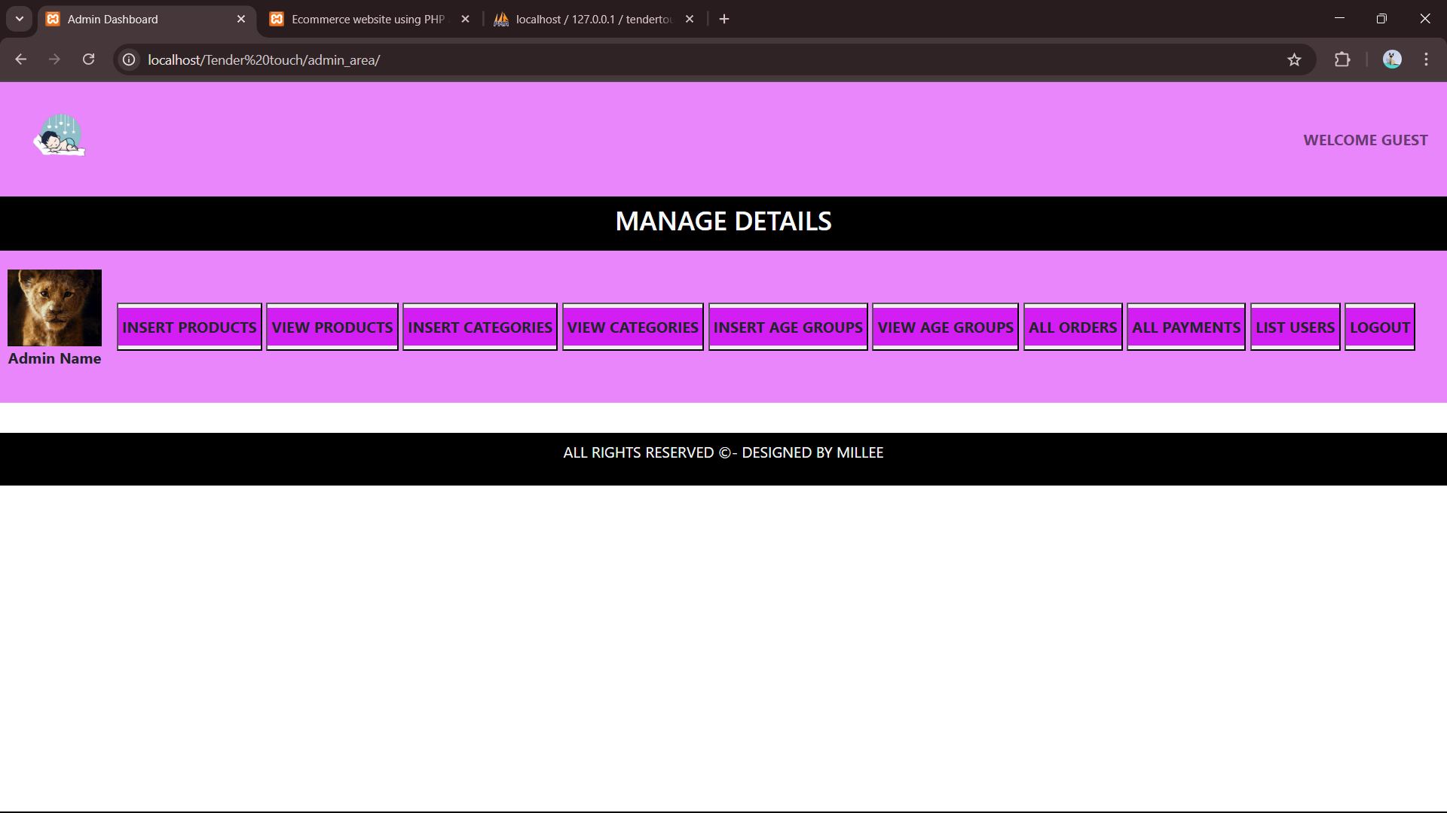

Slide 24
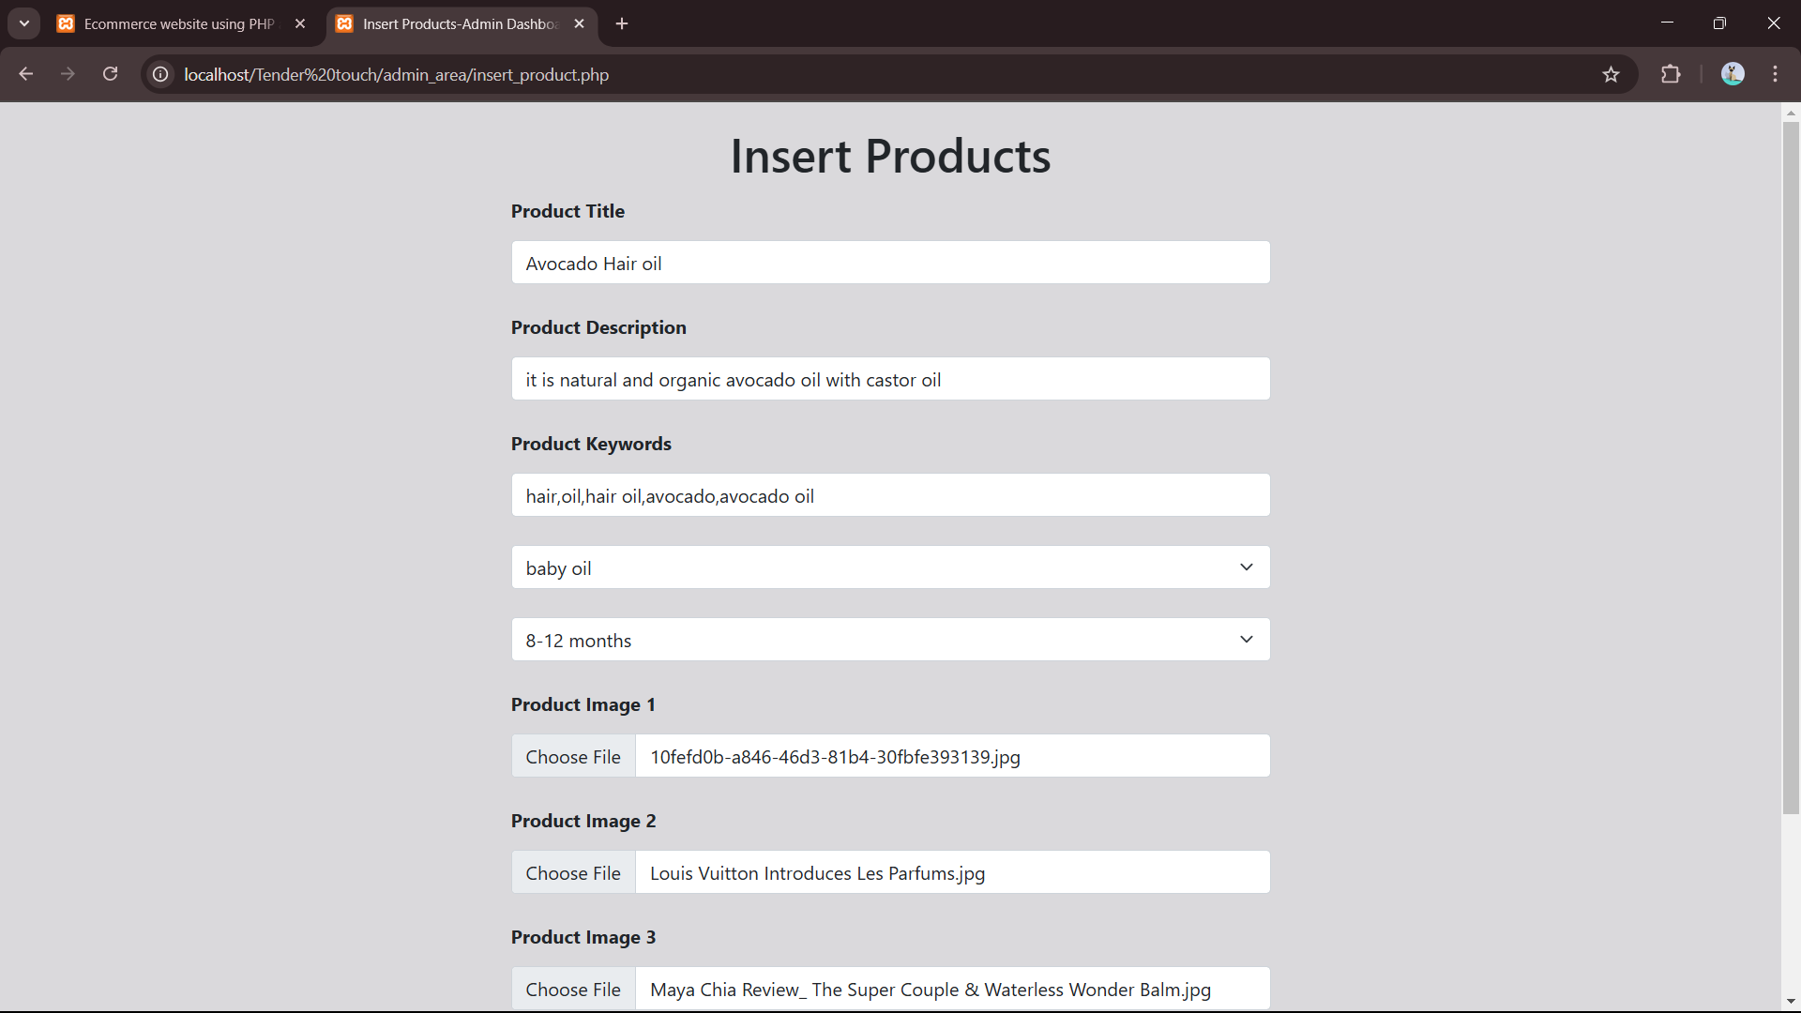
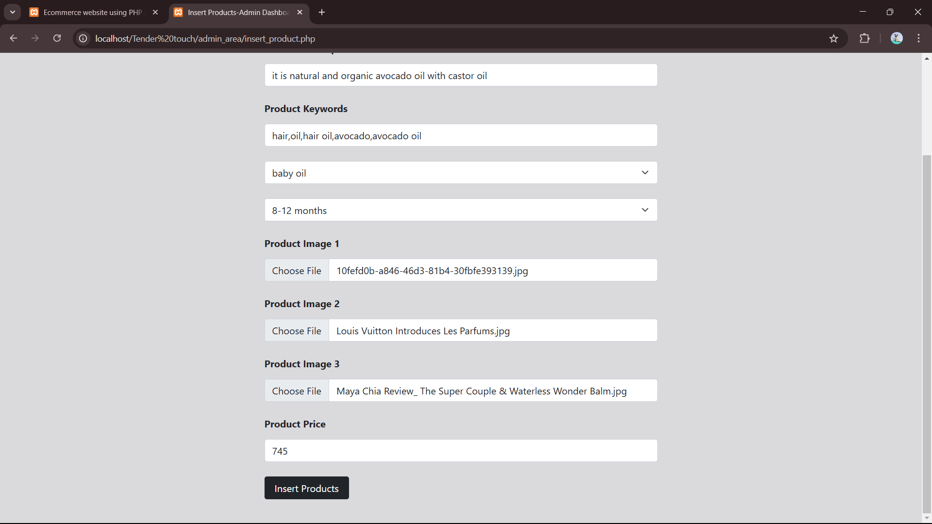

Slide 25
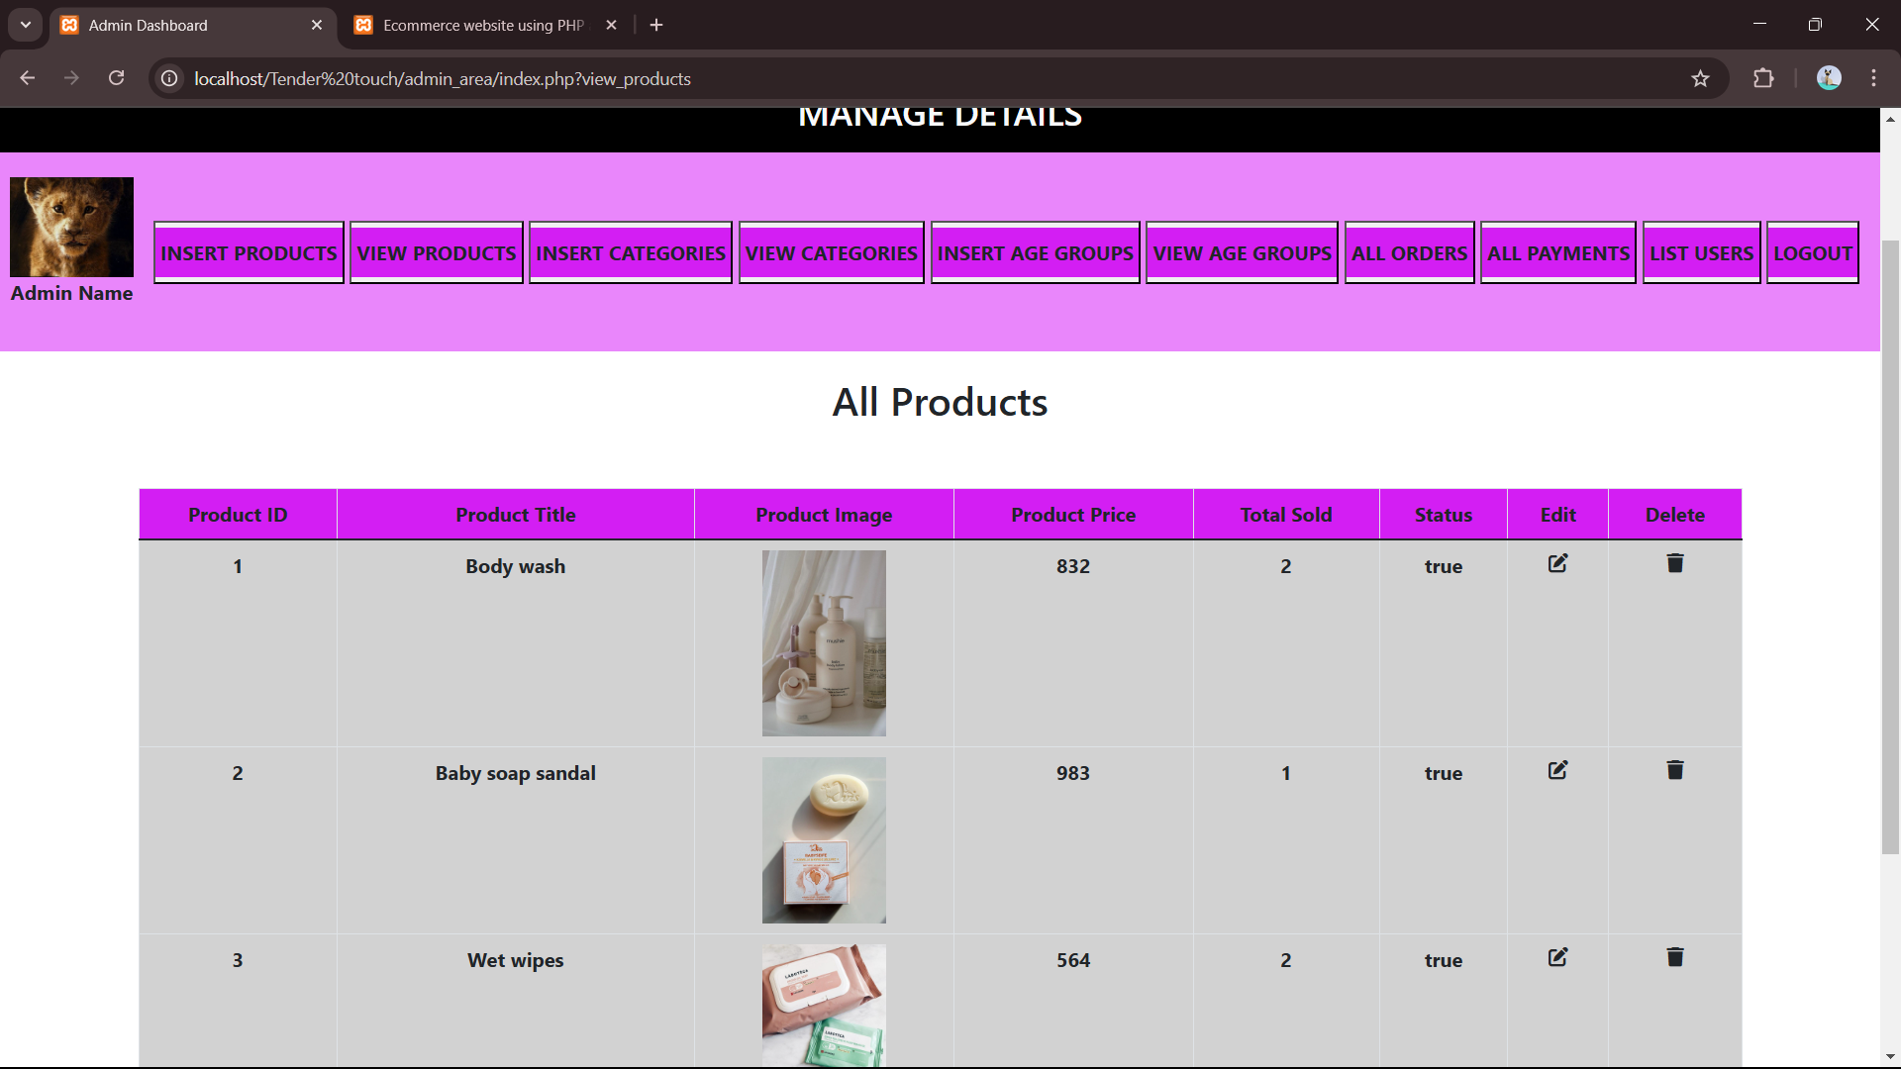

Slide 26
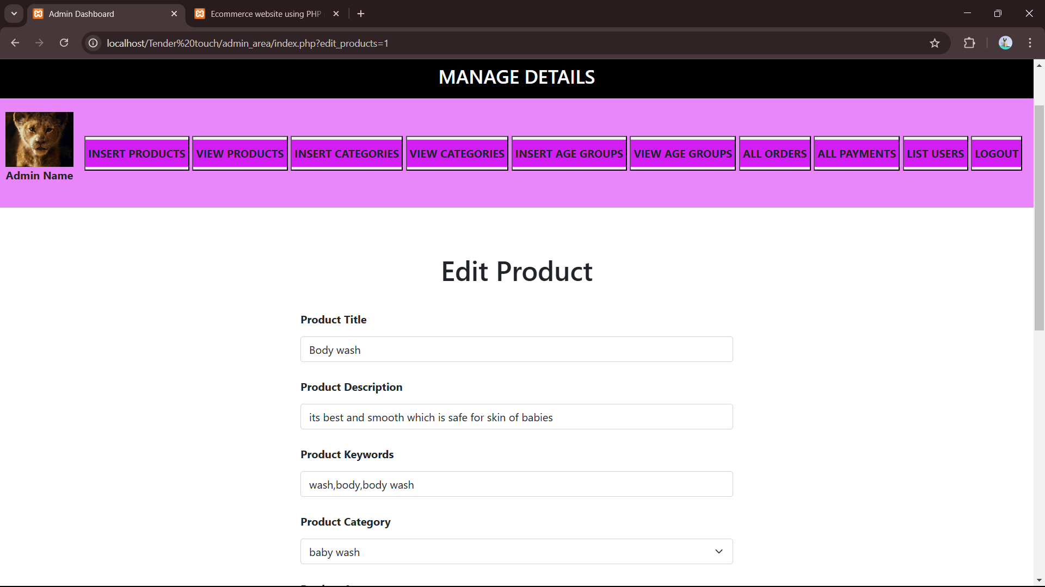

Slide 27
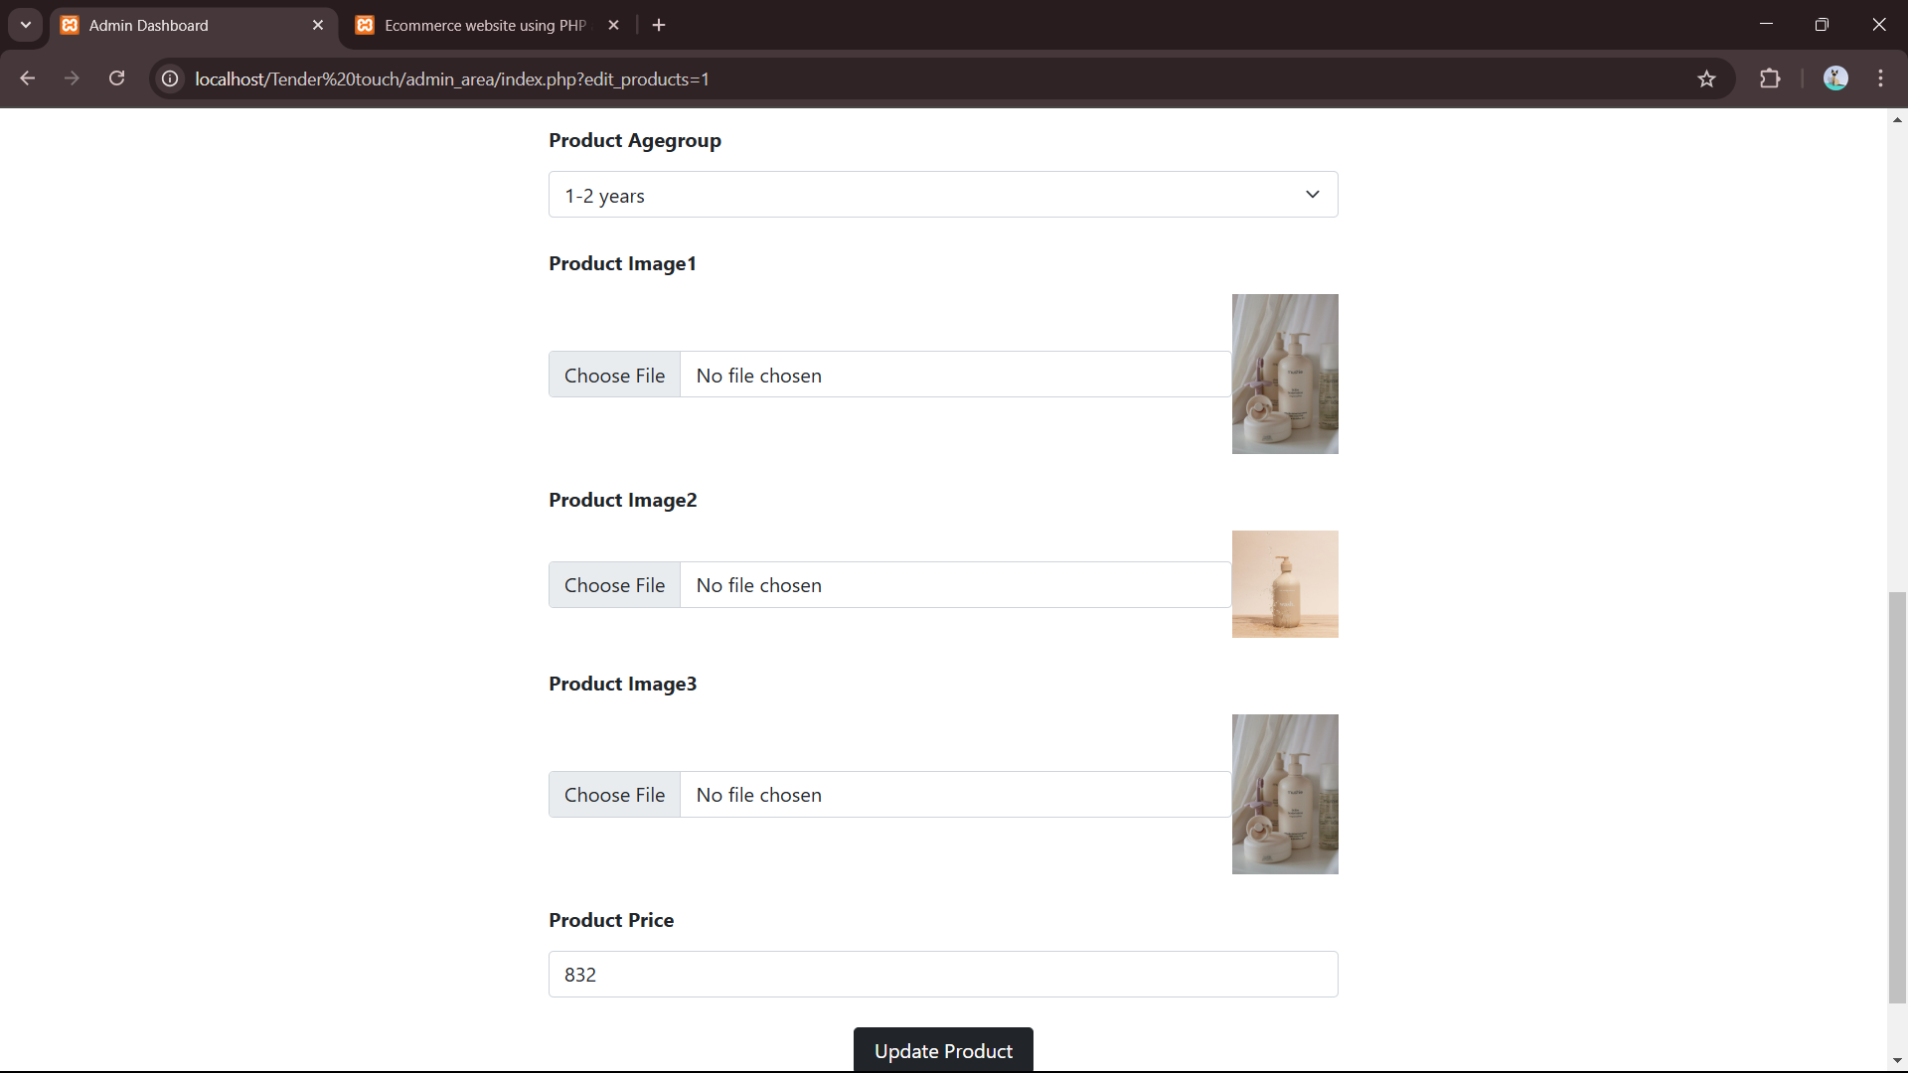

Slide 28
CONCLUSION
In conclusion, our skincare essential website aims to empower user with knowledge and quality products for a healthy and radiant skin. By providing expert advice, and curated selection of products. We strive to make the skincare accessible and enjoyable for everyone, promoting confidence and well being.

Slide 29
FUTURE ENHANCEMENT
There are several future enhancements that could be made to skincare website. Product Recommender Tool -Implement a simple quiz or a tool that recommends skincare products based on the baby's skin type, the concerns, and preferences.

Slide 30
REFERENCE
Duckett, Jon. "HTML and CSS: Design and Build Websites." 1st Edition, Wiley, 2011.
Welling, Luke, and Thomson, Laura. "PHP and MySQL Web Development." 5th Edition, Addison-Wesley, 2016.
Ullman, Larry. "PHP and MySQL for Dynamic Web Sites: Visual QuickPro Guide." 5th Edition, Peachpit Press, 2020.
Robbins, Jennifer Niederst. "Learning PHP, MySQL & JavaScript: With jQuery, CSS & HTML5." 4th Edition, O'Reilly Media, 2018.
Williams, Robin Nixon. "Learning PHP, MySQL & JavaScript: With jQuery, CSS & HTML5." 4th Edition, O'Reilly Media, 2018.
•

Slide 31
THANK YOU !

